Slide 1
TESTING ATM ANDROID APP
A.VRUSHI NATH REDDY
192110007​

Slide 2
AGENDA
Objective
Abstract
Proposed system
Flow chart
Concept map
Test cases
Applications used
Implementation & testing screenshots
Test case outcomes
Conclusion

Slide 3
Objective
The objective of testing the ATM simulator application using Appium is to ensure that the software functions properly and meets the requirements for security, and performance.

Slide 4
ABSTRACT
This presentation will cover the process of testing a software for an ATM machine simulator application using the Appium app.
Appium is an open-source tool for automating mobile and web applications, making it an ideal choice for testing ATM simulator application.
The presentation will cover the setup and configuration of Appium, as well as the various tests that can be performed using the tool.
These tests may include functional testing, performance testing.
The presentation will also discuss the advantages and limitations of using Appium for ATM simulator application testing, and provide examples of successful implementation.
Overall, the aim of the presentation is to demonstrate how Appium can be used to efficiently and effectively test ATM simulator application, ensuring its reliability and usability for customers.

Slide 5
Proposed System
Installation and setup of Appium on the development machine.
Installation and configuration of the required android/iOS development tools.
Obtain the ATM machine software apk/ipa file and install it on the emulator/real device.
Open the app in Appium and test whether the software is checking pin or not.
Test whether the software is taking correct input or not.
Develop test cases for the various functionalities of the ATM machine software using Appium.
Execute the test cases on the emulator/real device and record the results.
Analyze the results and report any bugs or issues found during the testing.
Repeat the above steps for different configurations and environments if needed.
Prepare the final test report and share it with the development team.
Continuously monitor and maintain the test cases for any updates or changes in the software.

Slide 6
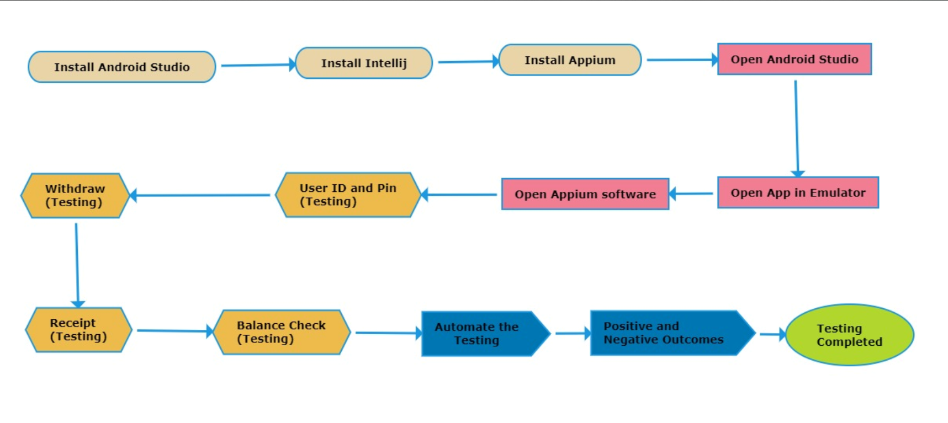
Flow chart

Slide 7
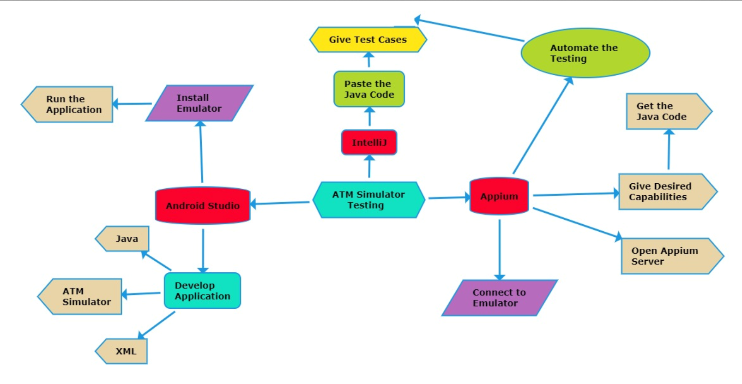
Concept map

Slide 8
test cases
Reading card
Entering pin
Change Pin
Incorrect/correct pin
Withdraw
Select Amount
Receipt
Balance check
Logout/Remove card
Add Users

Slide 9



Applications used
Appium IntelliJ Android Studio

Slide 10
Applications used
Appium
It is a open source automation tool.
It is also a automation frame work.
It can test web native and hybrid applications.
It supports multiple programming languages.
It works on emulator as well as real devices.

Slide 11
Applications used
Android Studio
It has integrated development environment.
It has fast emulator for app testing.
Used to develop applications for android devices.
It is an open source software.

Slide 12
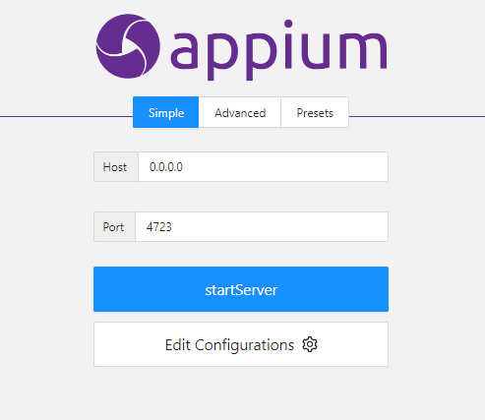
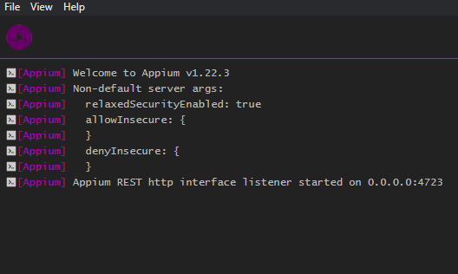
Appium server
Before starting server
After starting server

Slide 13
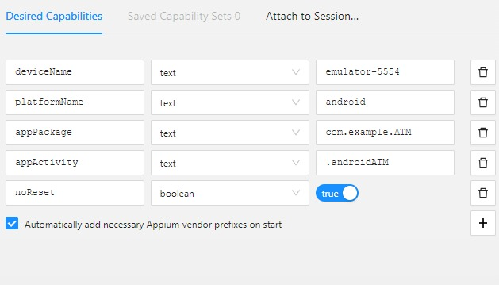
Implementation &testing screenshots
Give the Desired Capabilities in Appium Inspector.
It will start the session and gives you java code to start testing.
Paste the code in IntelliJ IDE and Start the Testing.

Slide 14
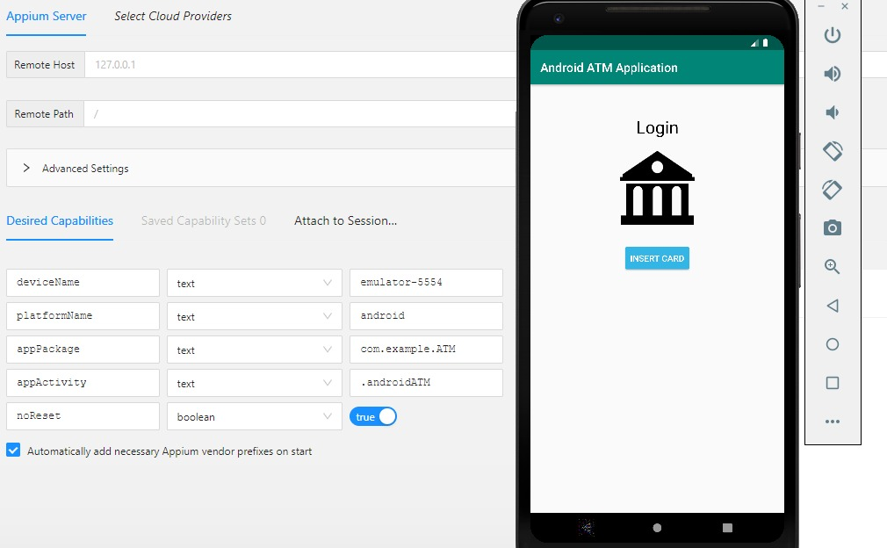
Implementation &testing screenshots

Slide 15
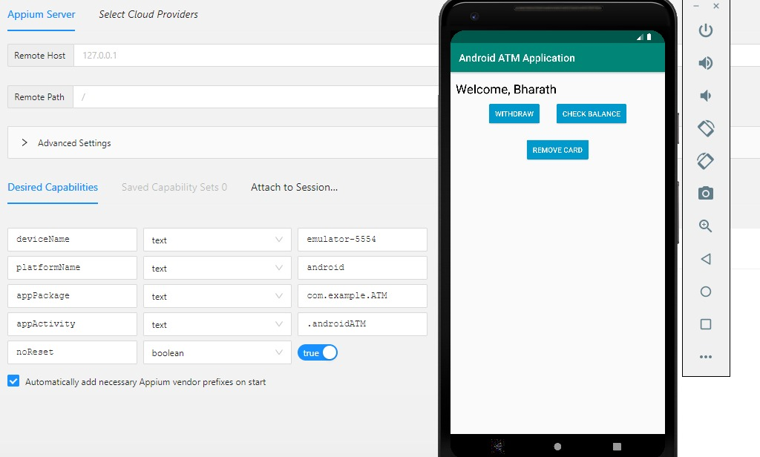
Implementation &testing screenshots

Slide 16
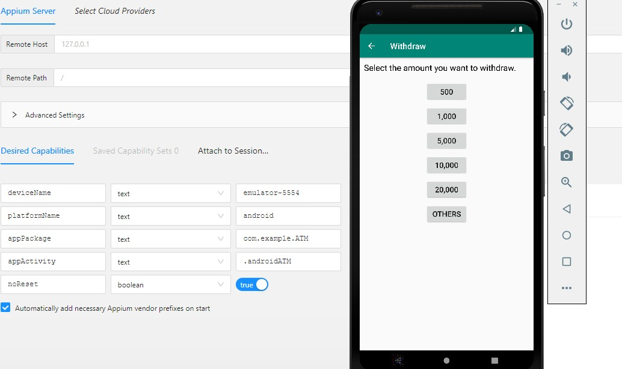
Implementation &testing screenshots

Slide 17
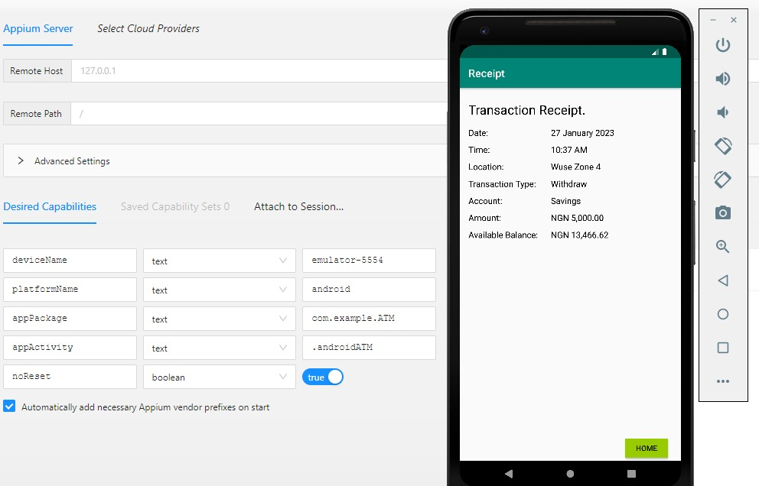
Implementation &testing screenshots

Slide 18
Test case outcomes
TEST CASE | OUTCOME
Verify the application can read the card | Positive
Verify whether the user can enter the Pin | Positive
Verify whether the user can change the Pin | Negative
Check if user gives Correct pin | Positive
Check If user can withdraw Cash | Positive
Verify if User can Select Amount | Positive
Check Whether User can get Receipt | Positive
Verify if User can Check Balance | Positive
Check if User can remove Card | Positive
Verify If the It can add more Users | Negative

Slide 19
conclusion
In conclusion, testing ATM software using Appium can be a valuable tool for ensuring the functionality and usability of the software.
Appium allows for automation of tests on both Android and iOS platforms, making it a versatile option for testing ATM software.
Additionally, its support for multiple programming languages and its ability to interact with the software in the same way a user would, allows for thorough and efficient testing.
Overall, using Appium for testing ATM software can greatly improve the quality and reliability of the software.
80% of testcases were positive and 20% were negative.
By enabling an option to add more users we can over come those negative 20%.

Slide 20
THANK YOU
By
A.Vrushi Nath Reddy.

